Slide 1

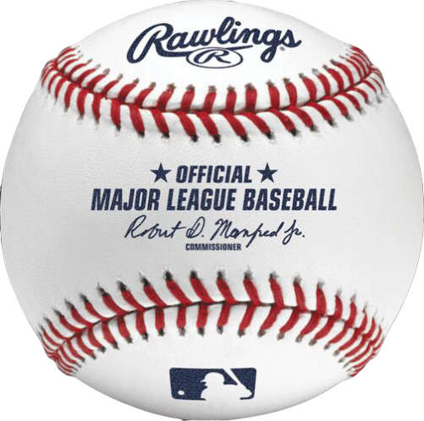

The Slot-ification of Baseball
Predicting the next pitch in
America’s Pastime
Joe Buzzelli
May 28, 2020

Slide 2


The Slot-ification of Baseball: A study in predicting the next pitch
Goal is to predict the next pitch type a Major League Baseball (MLB) pitcher will throw given the current scenario in a game that performs better than simply guessing the pitcher’s most frequent pitch
Applications of this study include sports gambling applications, in-game coaching strategy, and/or any other gamification of the MLB
?

Slide 3
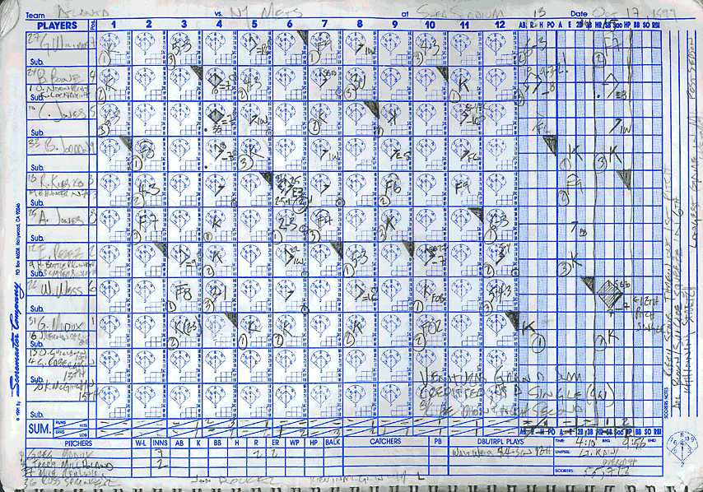
Input data to the pitch prediction model derive from a scorecard
This study includes data that would be on any scorecard
Any MLB scoreboard provides good summary of this project’s data

Slide 4
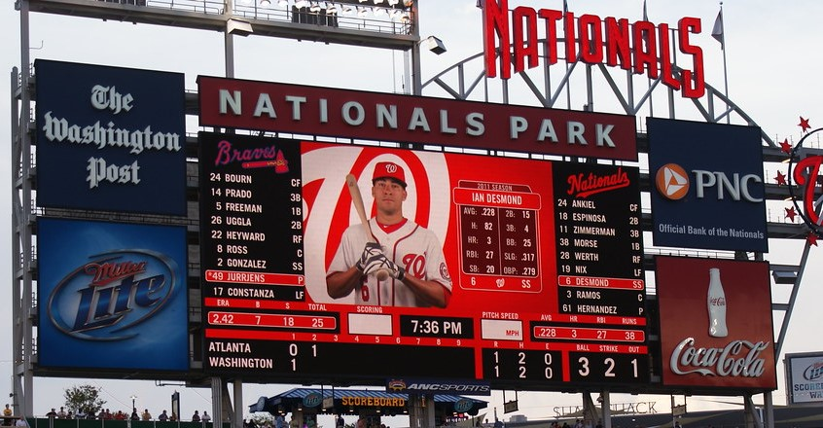
Batter metrics
Pitcher metrics
Game situation

Slide 5

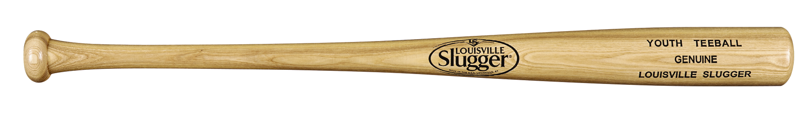
Data for this study includes almost 600,000 observations
Data collected for this study derive from MLB’s PITCHf/x stats from 2019
Every pitch thrown by a pitcher with at least 750 pitches
Every batter’s statistics as of the beginning of each game
Features created from the initial data include:
Running pitch totals for each pitcher per at-bat, game, batter, and season
Running batter’s statistics per the beginning of each game
Clustering of all MLB batters into four groups included in the modeling
595,412 Pitches
373 Pitchers
990 Batters

Slide 6
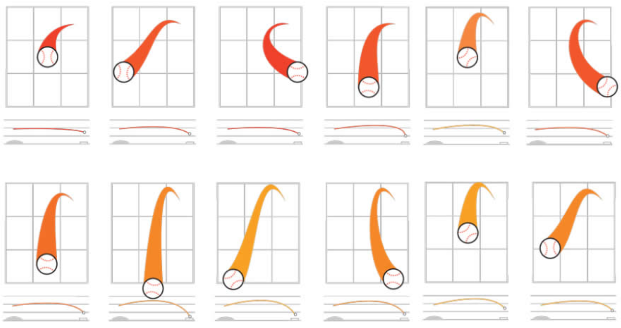
Pitch types focused on three groups
The pitch types in this experiment were grouped as either fastballs, change-ups, or movement pitches.
Fastball
Change-Up

Slide 7
The model outperforms naïve approach for fastballs and offspeed
By subtracting naïve predictions from the model’s predictions, the model outperforms picking the most frequent pitch type thrown
Movement pitches include seven pitch types and higher variability is expected given the parameters of this experiment
P
P
O
f
Fastball
Change-UP
Movement

Slide 8
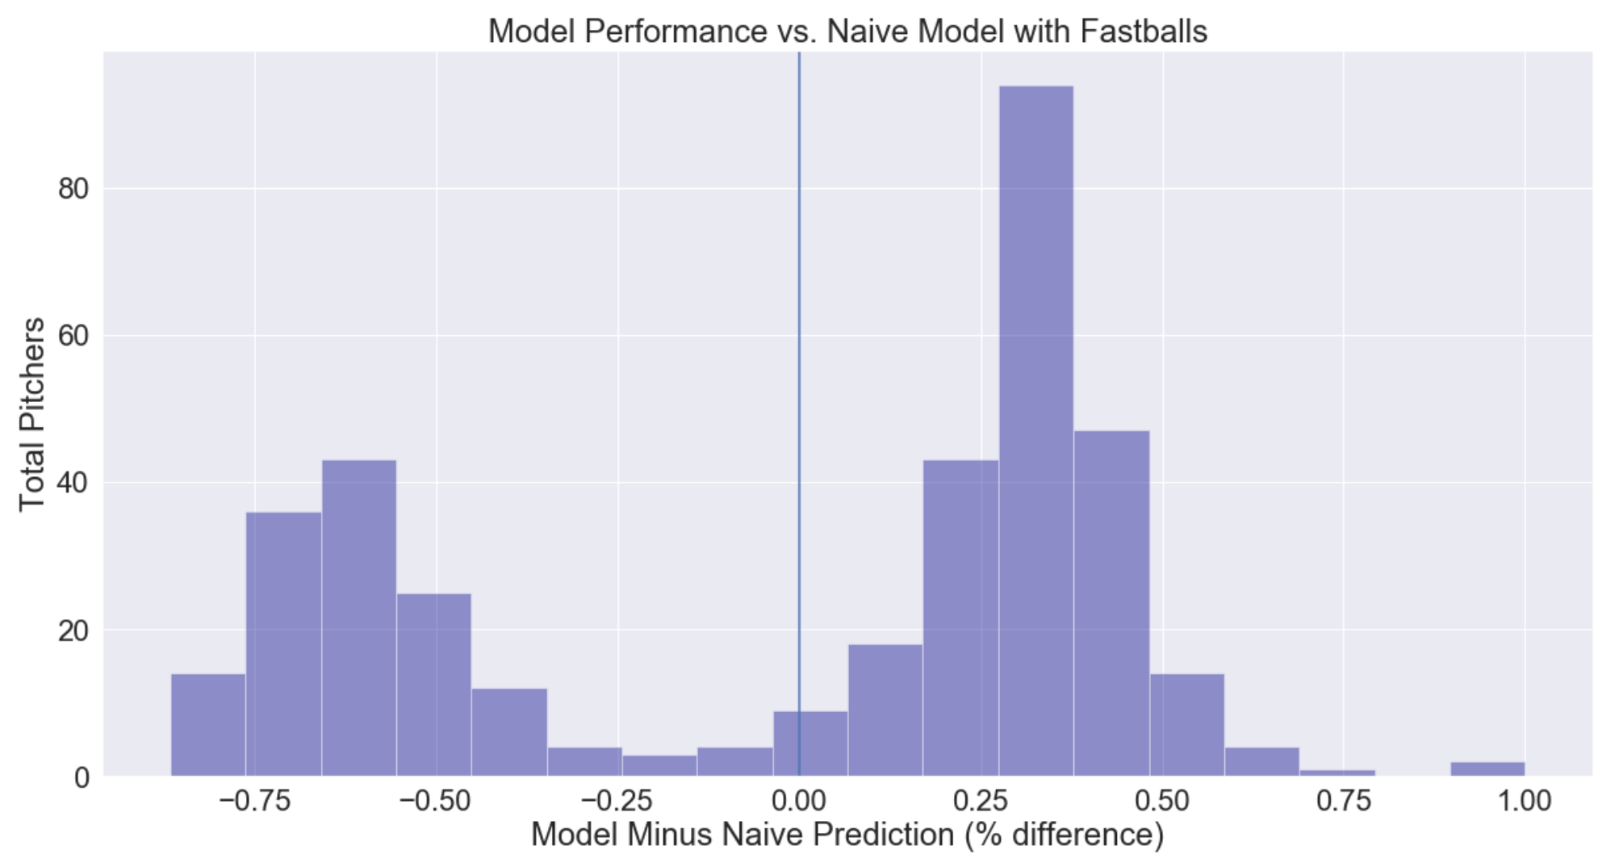
Model performs well with fastballs
Model predicts pitches better for 229 or 373 (61.4%)

Slide 9
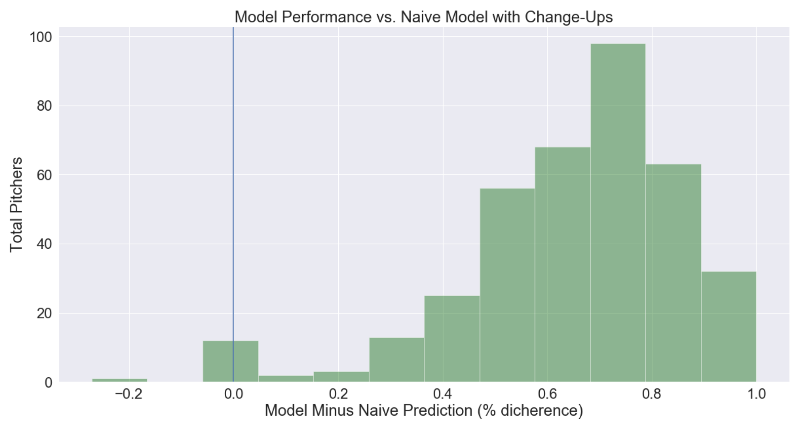
Model does even better with change-ups
Model predicts pitches better for 362 or 373 (97.1%)

Slide 10
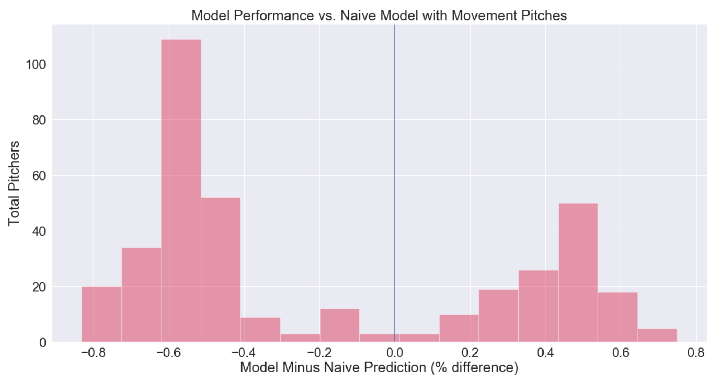
Model performs worse with movement pitches
Model predicts pitches better for 131 or 373 (35.1%)

Slide 11
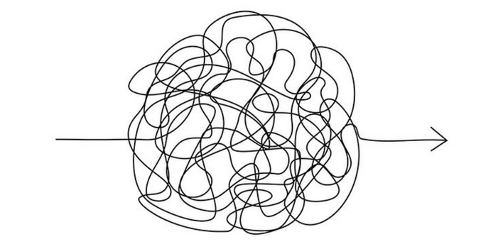
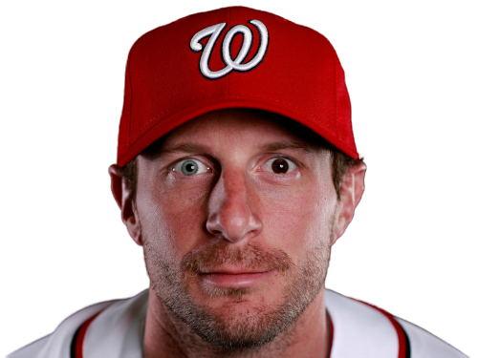
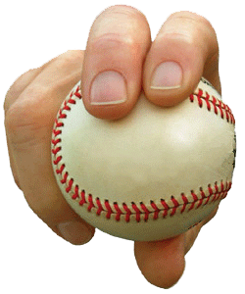
Final model performance… it’s complicated
The final model’s performance…depends
Predicting the pitch from a MLB pitcher is difficult
Some pitchers purposefully attempt to disrupt their own tendencies
Other pitchers just throw one pitch
Additional analysis is required across 373 pitchers as to why the model performs better than some pitchers than others

Slide 12
Future improvements
Investigating a cluster analysis on pitchers to explore correlations between grouping and appropriate models
Model on a pitcher/batter basis rather then modeling in the aggregate
Will yield 59,952 models
Create new features to include the prior pitch types and most frequent pitch type per situation for every pitcher/batter combination
More research into how MLB pitchers strategize specifically as it relates to pitch selection and how often these strategies are changed

Slide 13

Thank you for your time…
I’ll be happy to …
Field any questions
Joe Buzzelli
linkedin.com/in/joebuzzelli/

Slide 14

Appendix

Slide 15

The Slot-ification of the MLB increases transactions by 24,980%
 | Traditional Gambling | In-Running | Slot-ification
Description | Based on the final result of the game (winner or total score) | Based on the outcome of each hitter’s at bat | Based on the type of each pitch in a game
Transactions per MLB season | 162 games | 10,692 at bats per season (33 per game per team) | 40,630 pitches per season (3.8 pitches per at bat)
Percent increase from baseline | -% | 6,500% | 24,980%
Potential transactions (not to scale)

Slide 16
MLB’s PITCHf/x provides exhaustive data for Slot-ification
Data elements sourced from Baseball Savant at baseballsavant.mlb.com
Data Element | Transformation | Data Element | Transformation
Pitch type (target) | Ordinal | Inning | MinMax Scaling
Batter stance (left/right) | Categorical | Outs during at bat | MinMax Scaling
Infield alignment | Categorical | Batter’s whiffs | MinMax Scaling
Outfield alignment | Categorial | Batter’s swings | MinMax Scaling
Balls and strikes | Categorical | Batter’s takes | MinMax Scaling
Runners on base | Categorical | Batter’s strikeouts | MinMax Scaling
Nationals (home/away) | Categorical | Batter’s walks | MinMax Scaling
Batter’s batting average | Already standardized | Batter’s singles | MinMax Scaling
Batter’s slugging percentage | MinMax Scaling | Batter’s doubles | MinMax Scaling
Batter’s isolated power | MinMax Scaling | Batters triples | MinMax Scaling
Batter’s BA on balls in play | Already standardized | Batters homeruns | MinMax Scaling
Pitch number (per at bat) | MinMax Scaling | Batter’s contact types | MinMax Scaling
Pitch number (per batter per game) | MinMax Scaling | Batter’s RBIs | MinMax Scaling
Pitch number (per batter per season) | MinMax Scaling | Batter’s sacrifices | MinMax Scaling

Slide 17
The Random Forest performed best in initial testing
The table below outlines the models assessed in this analysis to include default results, cross validation (CV) scores
Model | Default Accuracy | CV Accuracy
Dummy | 33.3% | n/a
Linear Regression | 42.5% | n/a
Decision Tree Classifier | 99.9% | 45.2%
Random Forest Classifier | 99.9% | 54.2%
Gradient Boosting Classifier | 46.6% | 54.1%
Ada Boost Decision Tree Classifier | 99.9% | 53.2%
Support Vector Classifier | 33.8% | 38.0%
MLP Classifier | 65.4% | 51.9%

Slide 18
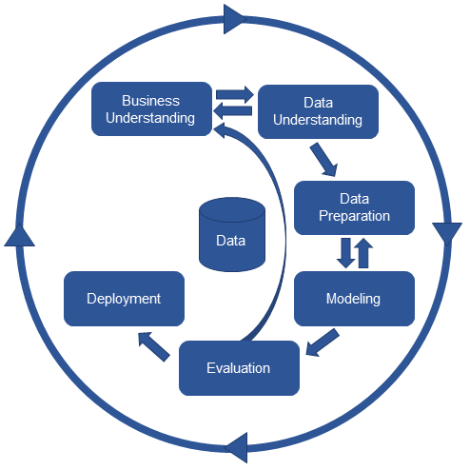
The experiment process followed the CRISP-DM framework
In the spirit of the cross industry process for data mining (CRISP-DM) framework, this experiment included several iterations
The selection and tuning of different models
Just Max Scherzer’s pitches for 2019
Scherzer’s pitches from 2015 to 2019
All pitchers from 2015-2019
Different standardization techniques for batters and other statistics
Different feature engineering techniques
Different pitch type groupings

Slide 19
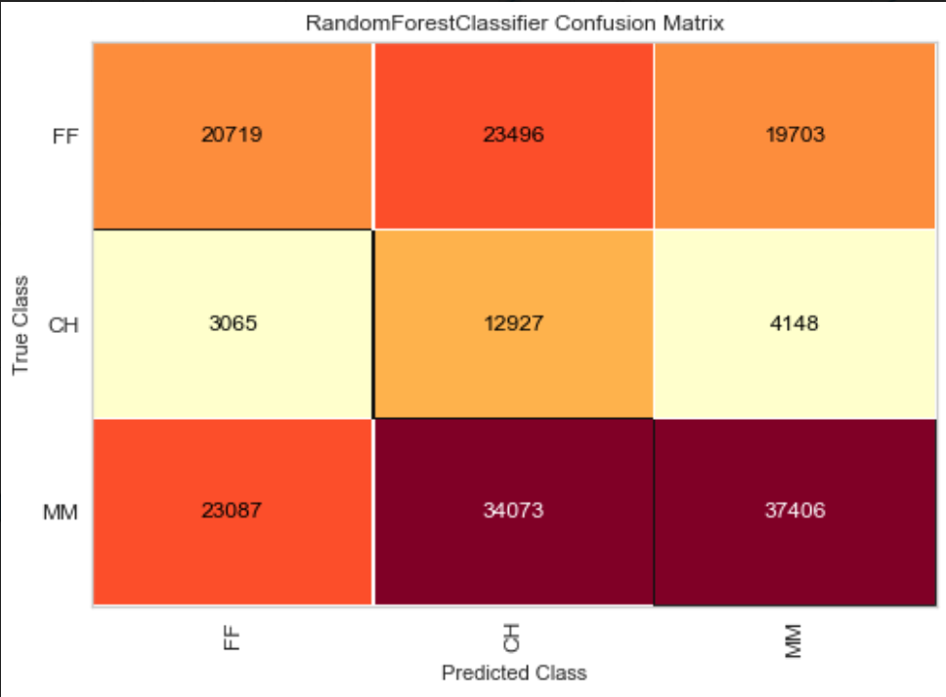
Confusion matrix for final, tuned Random Forest model
FF = Fastball
CH = Change-up
MM = Movement pitch

